Slide 1
Ramdog Help & Tutorial
Eric Dill 1/1/2014

Slide 2
Image Viewing

Slide 3
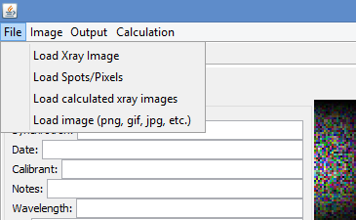
Click File:
Click “Load Xray Image”:

Slide 4
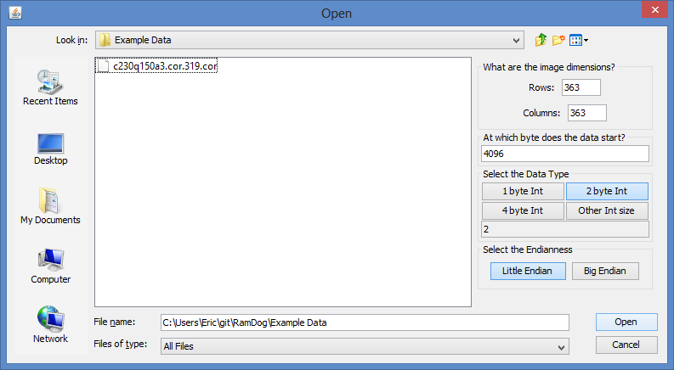
2
1
3
4
5

